Slide 1

E-Commerce Analysis
Vishanth s

Slide 2
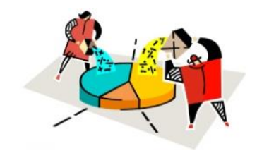
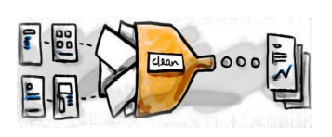


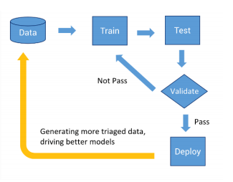
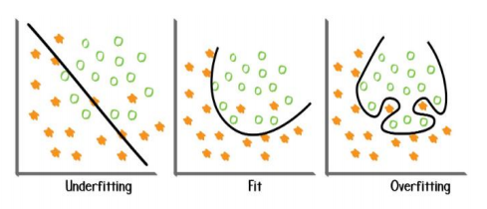
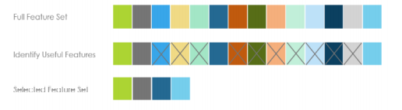
Architecture
Data Collection
Data Cleaning
EDA
Data Preprocessing
Validation
Modelling
Feature Selection

Slide 3

Data Collection
Data collection is the process of gathering and measuring information from countless different sources. Data must be collected and stored in a way that makes sense for the business problem at hand.
Dataset given by amazon consists of 10738 records with 12 features. Dependent variable Customer_category consists of 2 categories 0’s and 1’s

Slide 4
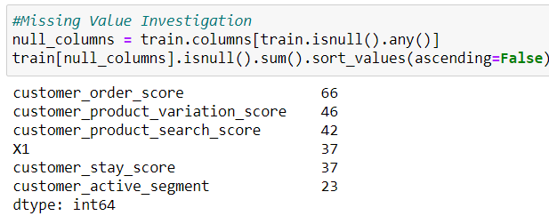
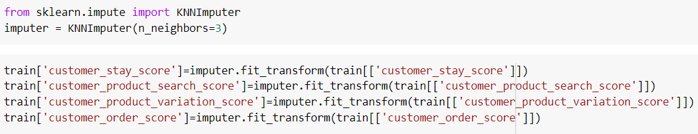
Data Cleaning and Preprocessing
Data cleaning refers to identifying and correcting errors in the dataset that may negatively impact a predictive model. Missing values identification, Missing values treatment, Outliers treatment and Handling duplicated records are done in this stage.
Features such as Order_score, Product_variation_score, X1, Active segment, Product_search_score and Stay_score contains missing values. All the values are filled using KNN Imputer.

Slide 5
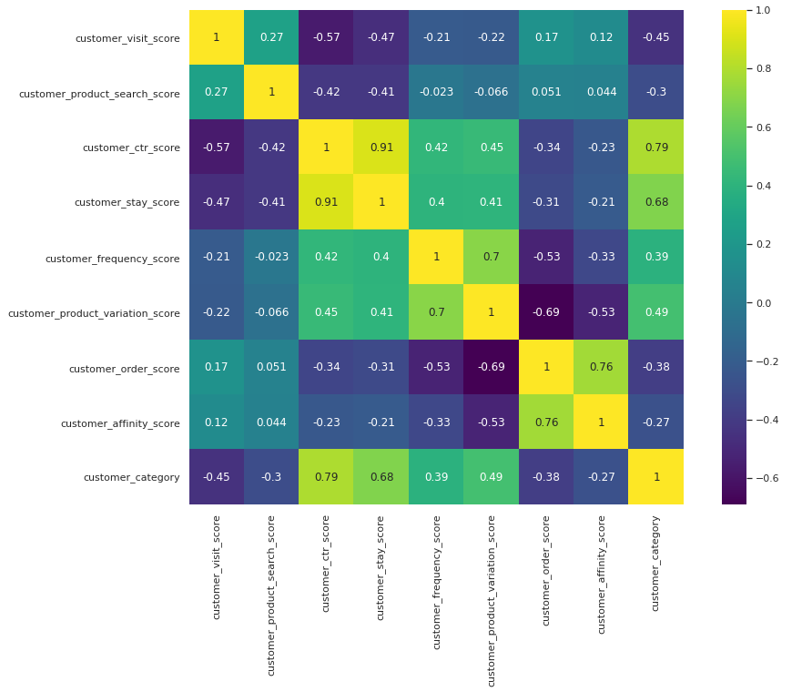
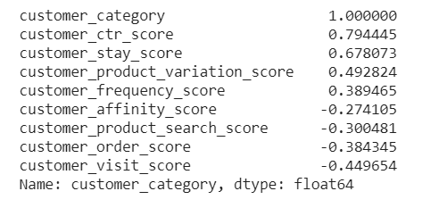
Feature Selection
Feature Selection is the process where we automatically or manually select those features which contribute most to our prediction variable or output in which we are interested in. Having irrelevant features in our data can decrease the accuracy of the models and make our model learn based on irrelevant features. Selecting important features and Dropping unimportant features are done in this stage.
Features such as Ctr_score, Stay_score, Product_variation_score, Frequency_score and Affinity_score are considered as important features by using correlation. Other features are dropped because the correlation values are less.

Slide 6
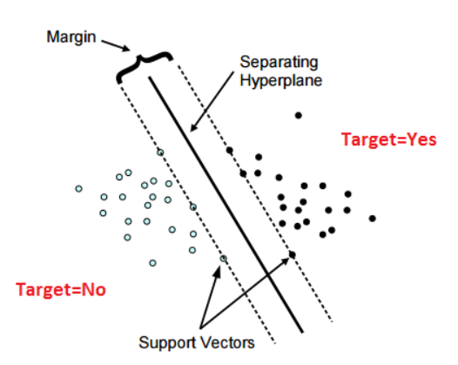
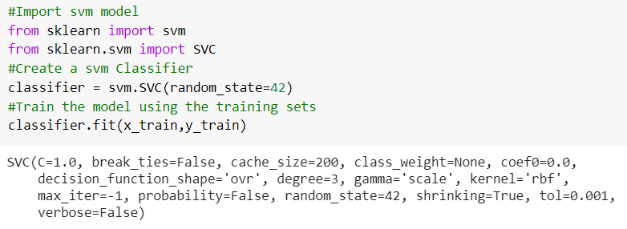
Modelling
The machine learning algorithm finds patterns in the training data such that the input parameters correspond to the target. The output of the training process is a machine learning model which we can then use to make predictions. Splitting the data into Train and Test, Fitting data into model, Model Training, Hyper parameter Tuning, and Predicting Output are done in this stage.
Support Vector Machines algorithm is used to classify the customer_category.

Slide 7
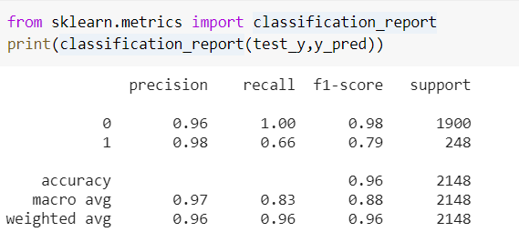
Data Validation
Model validation is referred to as the process where a trained model is evaluated with a testing data set. The testing data set is a separate portion of the same data set from which the training set is derived. The main purpose of using the testing data set is to test the generalization ability of a trained model. Model validation is carried out after model training. Testing Model, Evaluating Model Performance and Cross Validation are done in this stage.
The validation results are interpreted below.

Slide 8
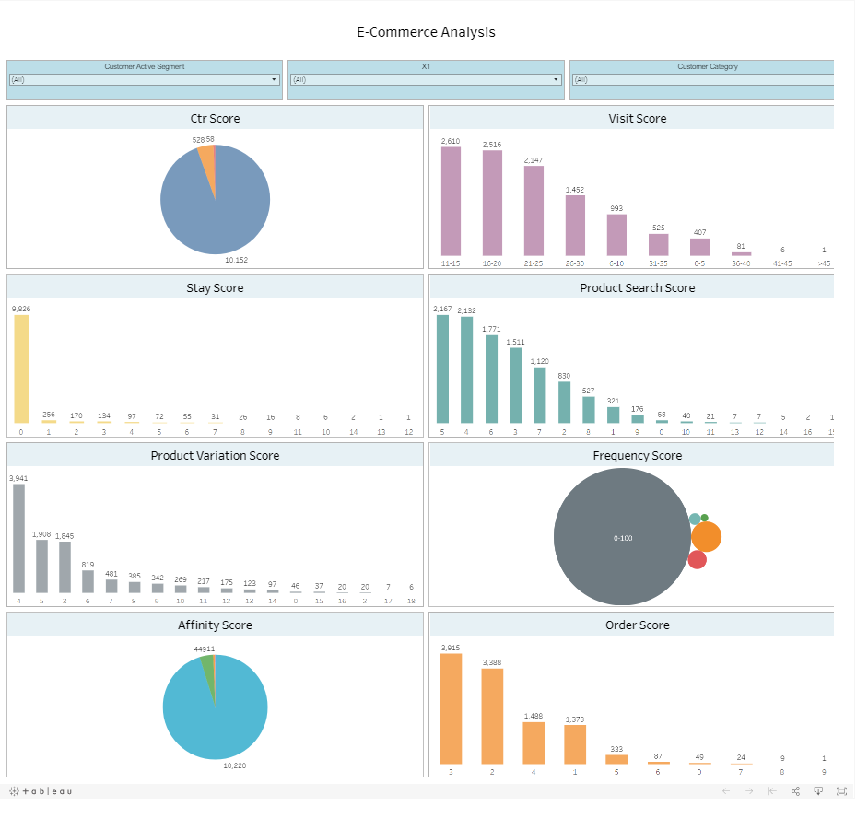
Data Visualisation
Data visualisation is done using Tableau Public. The Dashboard results are interpreted below.

Slide 9
Pros and Cons
Pros
SVM works really well for Binary classification
As the dataset contains less records SVM works good.
SVM is effective in high dimensional spaces
Cons
SVM doesn’t perform well when we have large data set because the required training time is higher
SVM also doesn’t perform very well, when the data set has more noise i.e. target classes are overlapping

Slide 10

Any Queries?

Slide 11

Thank you!

